Slide 2
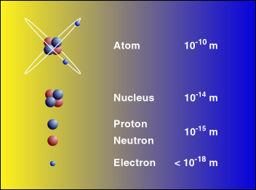
The constituents of an atom
Notes:
如何定义一样东西的大小？

Slide 3
The scientic development atomic theory
  1803, Dalton, the Law of multiple proportions and atomic theory
  1811, Avogadro：under the same conditions of temperature and pressure, equal volumes of different gases contain an equal number of molecules
  1833, Faraday's Laws of Electrolysis
  1869-70， Mendeleev: periodic table, relating the atomic number of elements and their chemical properties
  1860s，Maxwell’s velocity distribution
  1870s-1880s， Boltzmann Kinetic theory of Gases，Statistical Mechanics
  By 1900，most chemists and physicists believe the existence of atoms
  1827, Robert Brown: Brownian motion of small particles suspended in water
  1905, Einstein’s theory of Brownian motion, 1909 Perrin’s experimental proof

Slide 4
Dalton’s atomic theory (1803)
All matter is made of atoms
Atoms of a given element are identical
Atoms of different elements have different properties
Compounds are formed by the combination of atoms in simple, whole-number ratios
Chemical reactions involve the rearrangement of atoms
Dalton’s Law of multiple proportions

Slide 5
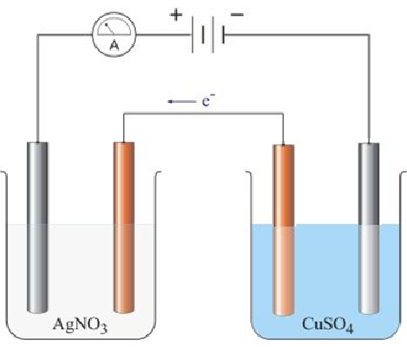

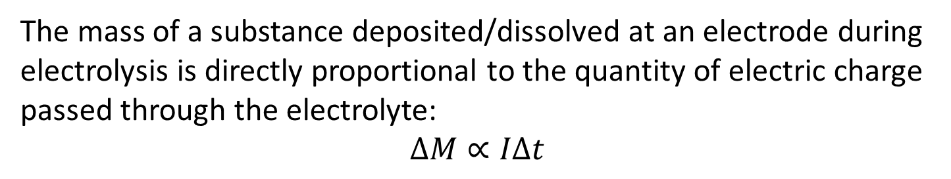

Faraday’s Laws of Electrolysis (1833)
The mass of a substance deposited/dissolved at an electrode during electrolysis is directly proportional to the quantity of electric charge passed through the electrolyte:
$$ΔM∝IΔt$$
$$A_{Cu}=64, A_{Ag}=108$$
For 54 g of Copper deposited on the silver rod in the right flask, how many grams of silver will be deposited on the copper rod in the left flask?
Ag⁺
Cu²⁺

Slide 6
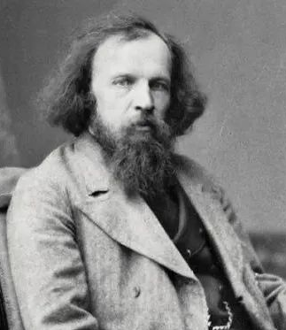
Mendeleev
（1870）

Slide 7
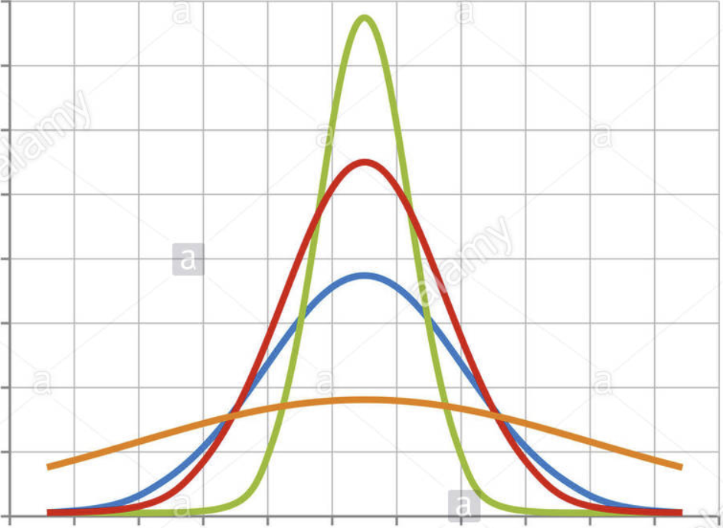
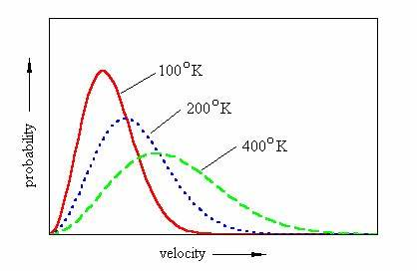
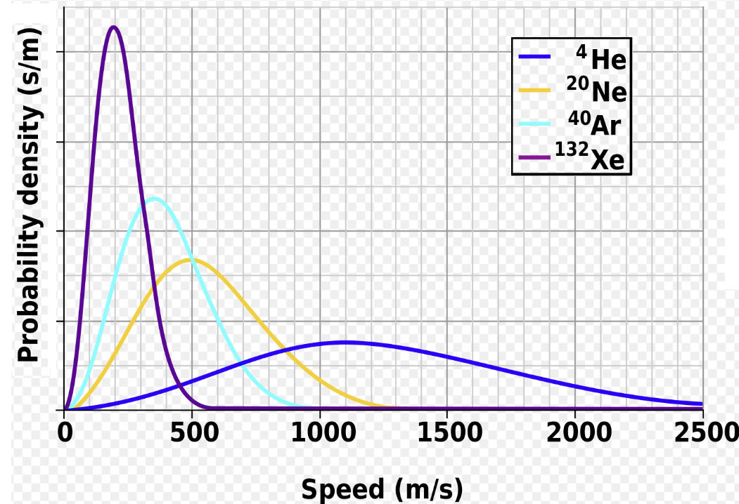


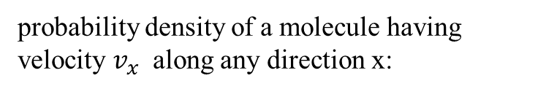

gas kinetics - Maxwell 速率分布 (1860)
probability density of a molecule having velocity $v_{x}$ along any direction x:
Low T
High T
$$0$$
$$v_{x}$$
Speed
Probability density of a molecule having speed $v$:
Notes:
“If you go at 17 miles per minute and take a totally new course 1,700,000,000 times in a second, where will you be in an hour?”

Slide 8
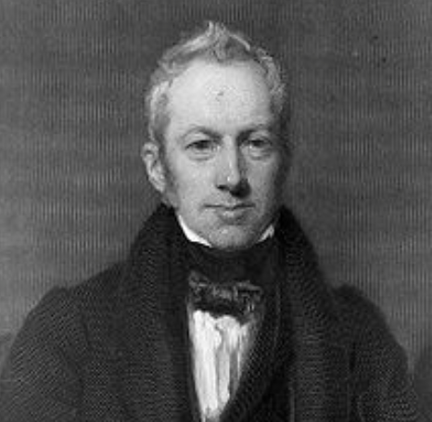
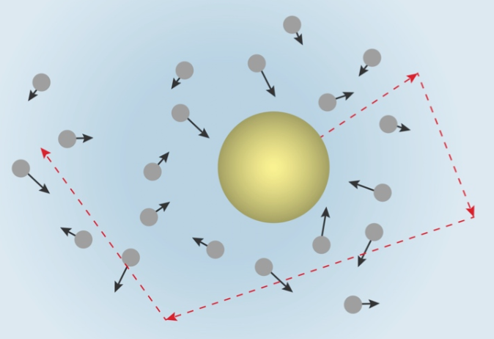
Brownian motion
1827 Brown: Jiggling of pollens suspended in water,.
Folks including Boltzmann believe it is caused by collisions of water molecules with the suspended particles.
1905 Einstein’s PhD thesis made the first quantitative study of this phenomena. Three year’s later his theory was experimentally confirmed by Perrin (1926 Nobel Prize).

Slide 9
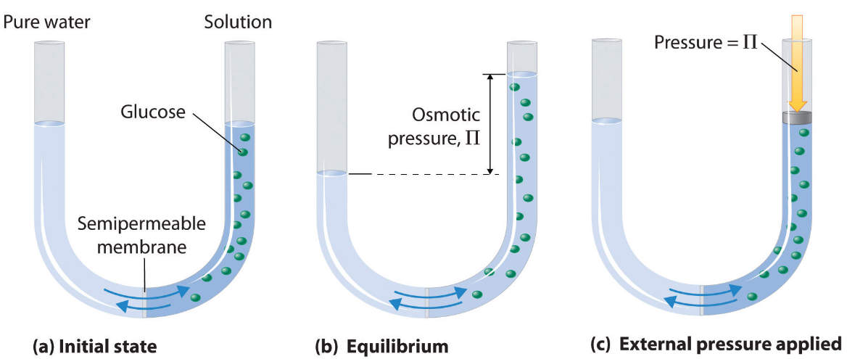

Van’t Hoff law (1901 NP for Chem) ：$p=nRT,$
$$p:\text{osmotic} \text{pressure} \text{of} \text{ideal} \text{liquid}\text{, }n:molar density$$
In his PhD thesis, Einstein described a new theoretical method for determining molecular radii and Avogadro's number.

Slide 10
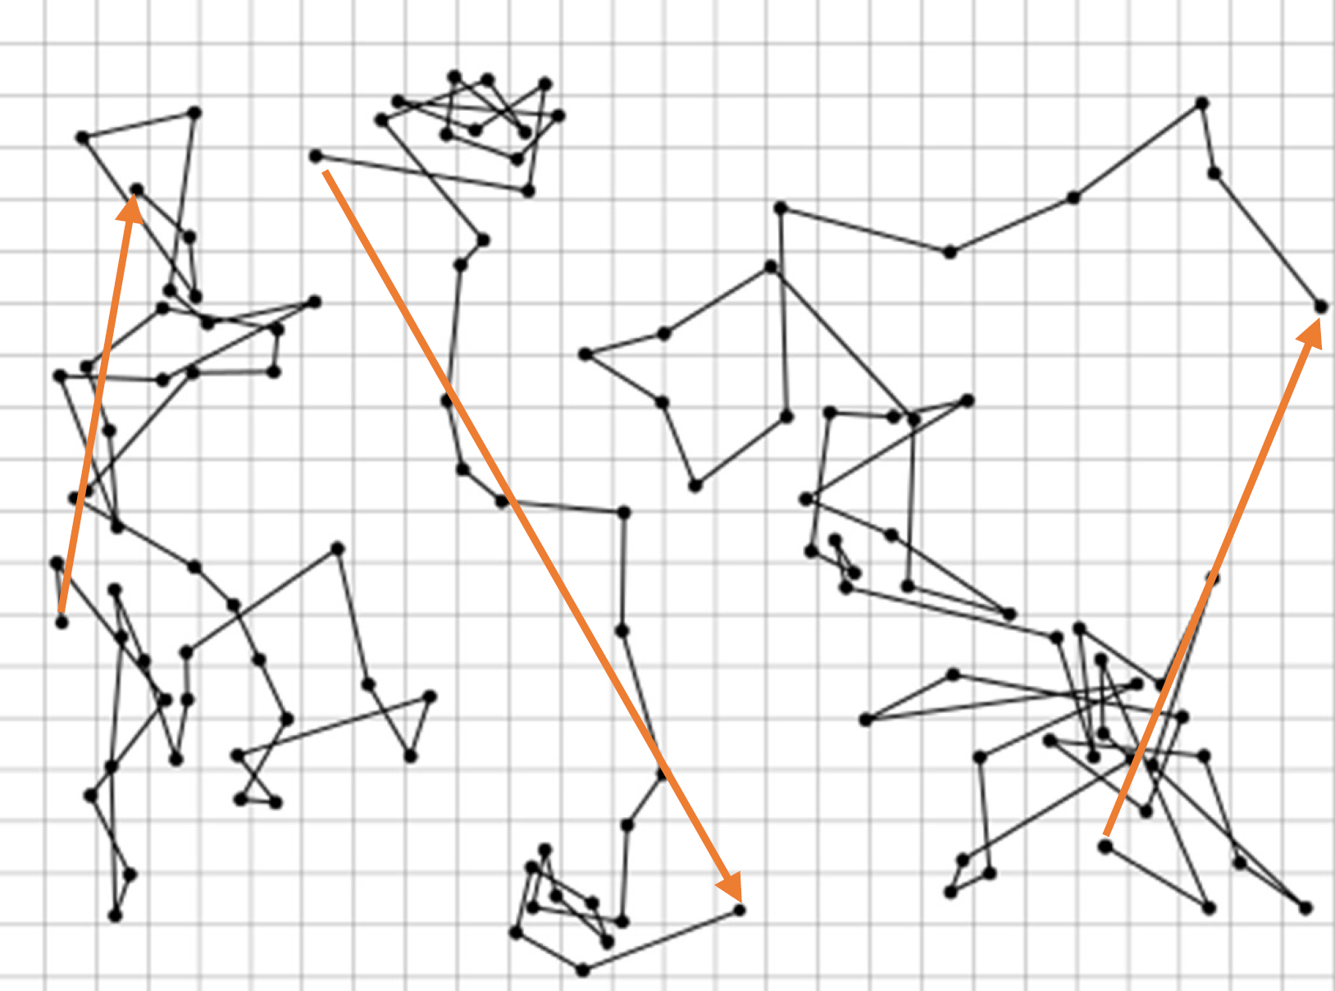


Perrin’s experiment
$$r$$
$$\left\langle r^{2}\right\rangle =4Dt$$

